Slide 1

115.113 Economics for Business
Global Economic Shocks

Slide 2
Introduction
Governments and Central Banks are usually able to stabilise economic shocks.
E.g. The Christchurch Earthquake (2011) led to a large loss of life and economic damage.
Sometimes shocks create crises at regional (e.g. Asian Financial Crisis) and Global levels (e.g. Global Financial Crisis or GFC).
These shocks are much harder to stabilise.
The NZ Government and Reserve Bank responses prevented a deep or lengthy contraction.

Slide 3
Common features of Financial Crises
Asian Financial Crisis (1997)
  High short-term interest rates had attracted foreign investment.
  This led to rapid rise in asset prices (real estate, stock market).
  When region’s Central Banks could not defend pegged currency, asset prices fell.
Global Financial Crisis (2008)
  Housing market in US (and Europe) was in price-bubble.
  When house-prices fell, many lenders became insolvent.
Financial Crises begin with a decline in asset prices

Slide 4
Common features of Financial Crises
A decline in asset prices
Widespread insolvencies in financial institutions
A loss of confidence in financial institutions
A credit-crunch
Economic downturn
A financial crisis spreads.
The investment shock comes from failure in the financial markets first.

Slide 5

The Asset Bubble
The US Housing Market

Slide 6
Housing Price Bubble
From 1995 house prices increased significantly
From 1996-2006 real house prices rose 80% in the USA, 110% in France and 185% in the UK.
What were the factors behind it?

Slide 7
Housing Market
Leverage Ratio
The proportion of debt relative to the equity the home-owner has.
If your leverage ratio was 8:1, you could borrow $8 for every $1 of equity you had.
Return to Equity
The equity is the amount of money the home-owner has paid.
The return to equity is:
$$\frac{change in value in house}{equity paid}$$
(𝑐ℎ𝑎𝑛𝑔𝑒 𝑖𝑛 𝑣𝑎𝑙𝑢𝑒 𝑖𝑛 ℎ𝑜𝑢𝑠𝑒)/(𝑒𝑞𝑢𝑖𝑡𝑦 𝑝𝑎𝑖𝑑)

Slide 8
Household Expectations
If house prices are expected to rise, households increase their borrowing.
If a house costs $200k and household pays $20k, its leverage ratio is 200/20 or 10
If house rises to $220k, the return to equity is 100%
Household has more collateral
House prices rise
Equity in house increases
Value of collateral rises
Borrowing rises

Slide 9
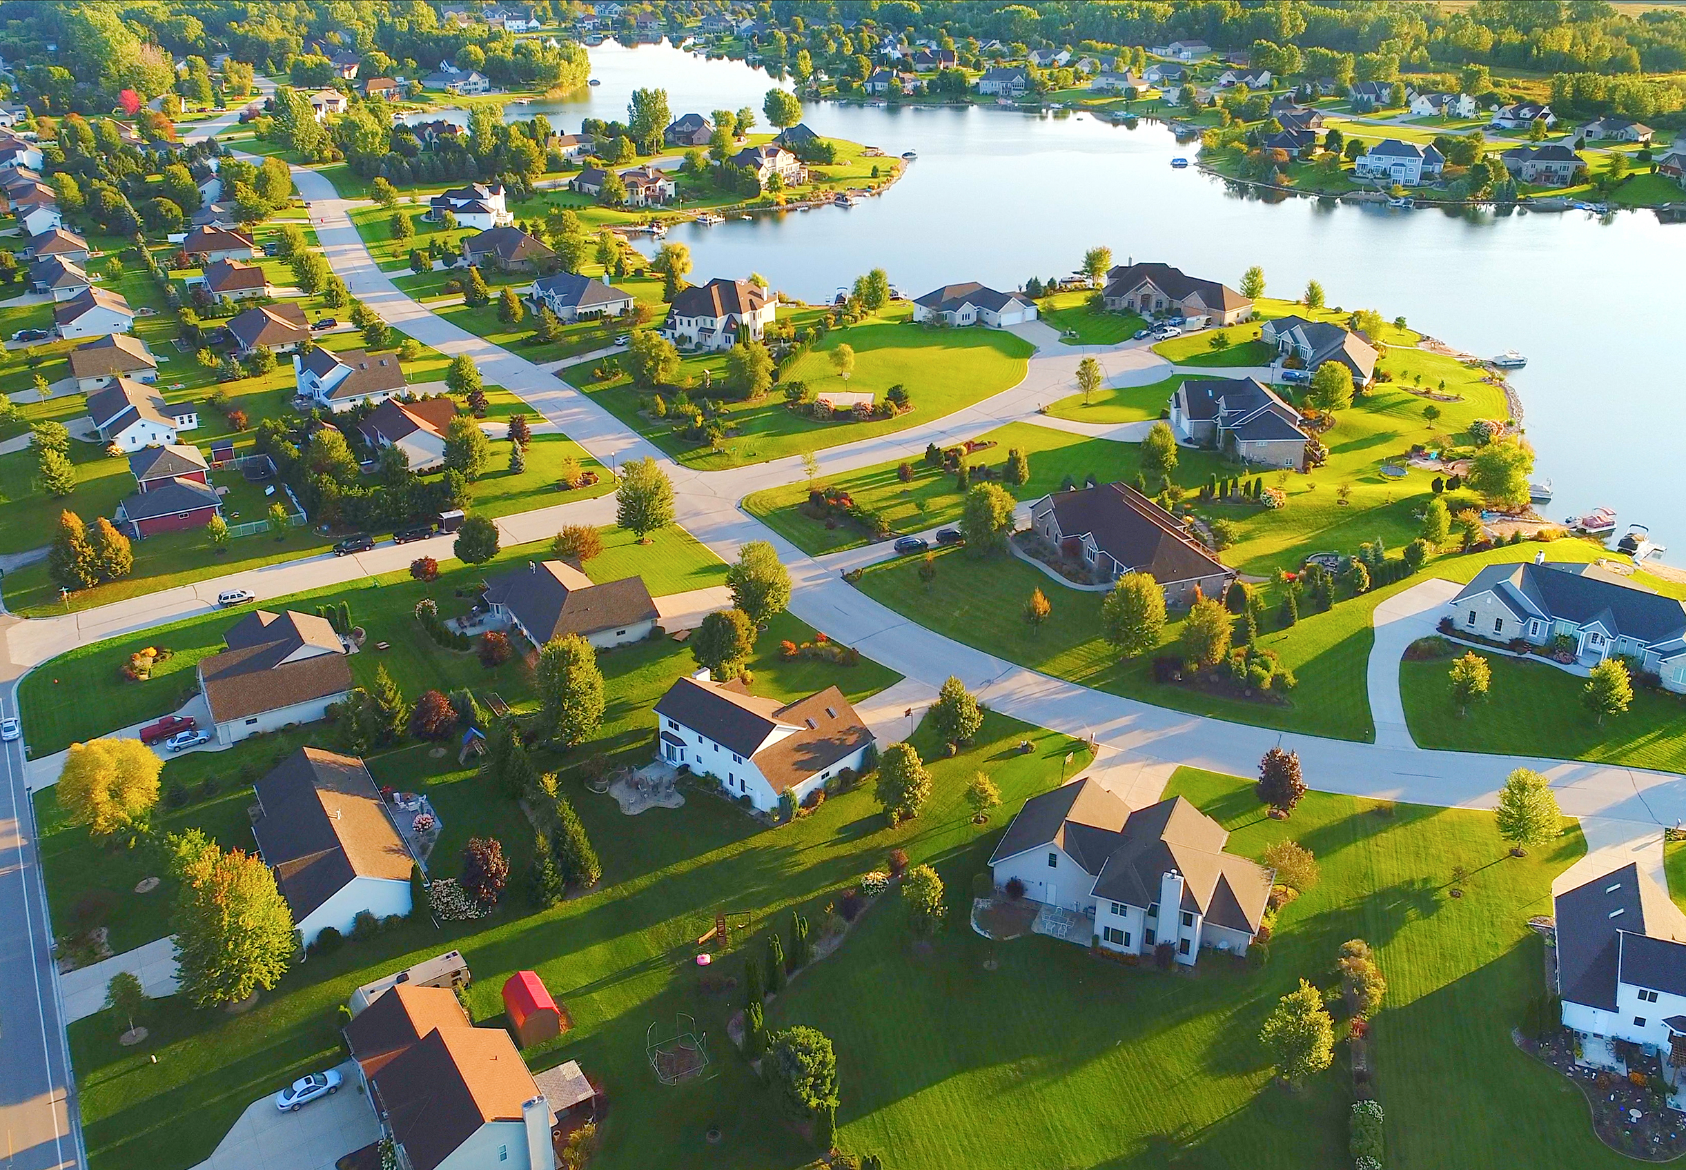
Summary: Demand Increases
People will demand more housing during a ‘price bubble’.
The return on equity exceeds other assets.
They can leverage increased value of their houses for more loans

Slide 10
Causes behind the asset bubble
Households borrowed to sustain house-price increases
Household debt in US rose to 135% prior to the crisis (Figure 17.9)
Financial deregulation and financial innovation
Banks extended more loans expecting house-prices to rise
Financial innovation led to new financial instruments based on mortgage securitisation
This expanded the lending to subprime borrowers
Subprime borrowers are riskier as they have less assets and income

Slide 11

The Problem with Banks
Banks (and related Financial Intermediaries) have, compared to other firms, very high levels of debt.
All their deposits are debt.
They must repay these deposits on demand.

Slide 12
The Economics of Banking
Banks take many small deposits and convert them into larger, long-term loans.
They must pay interest on their deposits (cost).
Their revenue comes from the interest on their loans.
What if borrowers can’t repay their loans?
The Bank can sell the collateral used by the borrower.
This is costly so the Bank does not get all the value of the collateral.

Slide 13
Solvency
A Bank will be solvent if:
  The value of its loan repayments plus
  The value of the (liquidated) collateral
  exceeds
  The value of their deposits and the interest payments on these.

Slide 14
Toxic Balance Sheet
This describes a Bank whose assets (loan repayments and collateral) are less than its liabilities (deposits and repayments).
Balance sheets can become toxic if borrowers stop repaying loans and their collateral drops in value.

Slide 15
Summary
Loan repayments (interest) fund the depositors (debt owners) interest payments.
If loans cannot be repaid, the FI liquidates collateral to repay their depositers.
If the collateral and loan repayments exceed the deposits the FI is solvent.
If the collateral loses value and loan repayments drop, the FI can quickly become insolvent.
Banks and similar Financial Intermediaries(FIs) operate at high debt levels.
Deposits are their debts
Loans are their assets

Slide 16
Example 4.1
Suppose a person buys a house for $300,000. The deposit they pay is $60,000. A year later the house increases in value to $330,000. Their return on equity is
10%
30%
50%
100%
Select the best response to this question.

Slide 17
Example 4.2
Suppose the person has a leverage ratio of 6. If they sold their first house for $330,000, what loan could they now get?
$300,000
$330,000
$360,000
$540,000
Use the information in the previous question.
Suppose a person buys a house for $300,000. The deposit they pay is $60,000. A year later the house increases in value to $330,000

Slide 18
Causes of GFC
Demand for loans has to be met by supply.
Banks and related Financial Intermediaries were willing to supply more loans
Mortgage Securitisation was a way to reduce the risk of lending to subprime borrowers.
Collaterilized Debt Obligations (CDOs) reduced the risks to Banks from lending to subprime lenders, including NINJAS
NINJA- a subprime borrower with No Income, No Jobs or Assets.
Lax lending practices led to excessive lending in subprime markets

Slide 19
A Mexican strawberry picker with an income of $14 000 and no English was lent every penny he needed to buy a house of $724 000
Lewis- 2009

Slide 20
CDOs
A mortgage-backed security is created
This collects many subprime mortgages together.
These are separated into categories (tranches)
The tranches reflect risk (AAA= safest, B= riskiest)
The CDO receives revenue from the mortgage payments. FIs used these to repay their investors.
AAA CDOs get paid out first, then AA and so on
If subprime borrowers start defaulting the system is at risk of collapse
How CDO’s work
The idea is risk can be diversified (spread) which makes them safer.

Slide 21
Risks
Default Risk
The probability an individual borrower will be unable to repay their loan.
This risk is not related to the other borrowers.
Borrower A’s inability to repay is not related to Borrower B.
Systemic Risk
The probability a borrower will be unable to repay their loan based on economy-wide changes.
This risk is related to other borrowers.
If Borrower A cannot repay it is likely Borrower B cannot repay.

Slide 22
Causes of GFC
Between the creation of CDOs and the GFC, CDOs increases in value by 17 times.
CDOs were priced by 2000 formula developed by investment banker, David Li.
This assumed prices of financial assets reflected their default risk
Also ignored that systemic risks- like house prices going down at a national or global scale
Novel financial instruments investors didn’t understand.

Slide 23
Causes of GFC
Rating agencies such as Moody’s and Standard and Poors also contributed
Their assessments of the risks of these mortgage securities and the financial institutions that issued them was lax and permissive.
Investors using these ratings to make buy these securities were led to believe they were less risky than they truly were.

Slide 24
Causes of GFC
The increasing rate of home-ownership was seen as desirable by many Governments and supported by policies
Financial Institutions believed they were “too-big-to-fail” and they could rely on a government bailout.

Slide 25
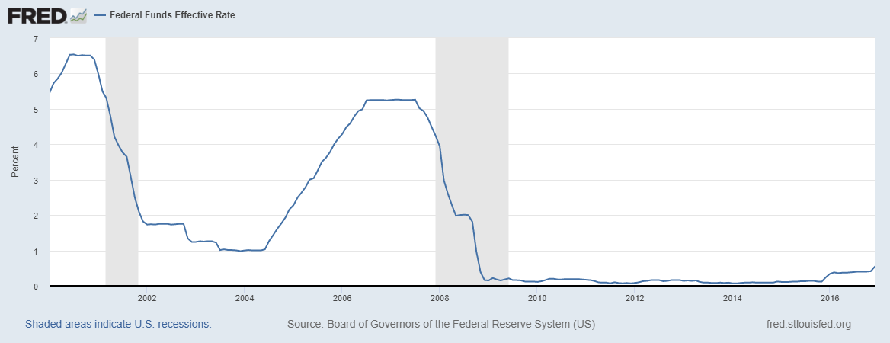
US Interest Rates

Slide 26
Causes of GFC
Monetary policy in the US was loose following the dot-com bubble
Interest rates were dropped from 6% to 2% in 2000-01 and stayed there
Money was relatively ’cheap’ and this (probably) helped the housing bubble started

Slide 27
The Gamble
US households had gambled on the house-price bubble, fuelled by increasing borrowing was sustainable.
Banks and other financial intermediaries gambled that house prices would also keep rising.
The top 5 US Investment banks were $4.1 trillion in debt in 2007 (about 30% of the US GDP)
Until house prices didn’t, subprime borrowers started to default, and bank/holders of CDOs couldn’t pay their lenders back.
Everyone was gambling house prices would continue to rise.

Slide 28
The Financial Crisis begins
US Financial Institutions became distressed
Some, e.g. Lehman Brothers AIG, Fanne Mae and Freddie Mac, went bankrupt.
Investors stopped lending to many FIs and their assets were also devalued.
Confidence falls
The Financial Crisis begins…

Slide 29
Debt Contagion
Financial Institutions normally direct borrowed money to firms and households to invest.
Panic over who was exposed and how badly, led to financial firms to stop dealing with each other (September 2008)
Short-term funding markets shut down
Equity and term funding markets collapsed
The Credit Crunch hits firms wanting to invest.
Panic in financial markets results in a credit crunch
“Investment” initially falls for a reason unrelated to business confidence
Financial markets aren’t doing what they’re supposed to

Slide 30
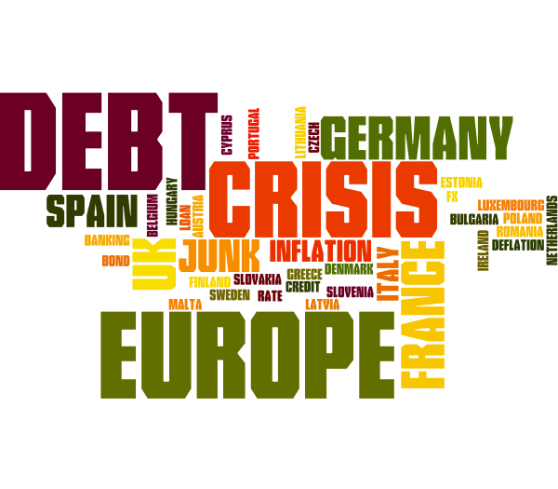
The European Debt Crisis
Europe had two unique factors:
All countries shared the same currency and faced the same interest rates set by the ECB.
Bank assets were much larger than GDP

Slide 31
Size of Bank assets
Country | Assets as % of GDP
USA | 81%
Italy | 259%
Germany | 294%
Spain | 325%
France | 416%

Slide 32
Eurozone Consequences
Low growth in Germany resulted in
ECB setting interest rates low to stimulate growth in German economy
This over-stimulated economies like Spain
Funds flowed from countries like Germany to countries like Spain, inflating housing bubbles.
Consumer demand rose in countries like Spain, creating a trade deficit
Spain’s currency could not depreciate because it was the same as Germany’s.
Countries in the Eurozone cannot set independent monetary policy
They must also use the same currency (Euro)

Slide 33
European Debt Crisis
Banks and governments were lending each other money, often based on property elsewhere also.
Europe faced a dilemma by early 2010 with Greece’s debt levels
Greece owed Portuguese Banks $10bn
Portugal owed Spanish Banks $86bn
Spain owes German Banks $238bn and French Banks $220bn.
Spain owes Italy $31bn which owes France $511bn.
If Greece isn’t rescued, the financial system collapses.

Slide 34
Consumption falls
Households decrease spending, especially of durable goods.
Cars and machinery sales fall.
East Asian economies suffer drop in exports.
Japan industrial output falls 30% in 6 months.
Firm’s cut back investment activity
Unemployment starts rising

Slide 35

Car Woes
In US car market new car sales fell from 16m a year to 10m a year.
The Chrysler and GM bailout cost $US80bn.

Slide 36
Asset prices fall…again
The response of Stock Markets to these bankruptcies, downgrades and downturn in economic activity is to fall.
Automatic stabilisers are inadequate to deal with the crisis

Slide 37
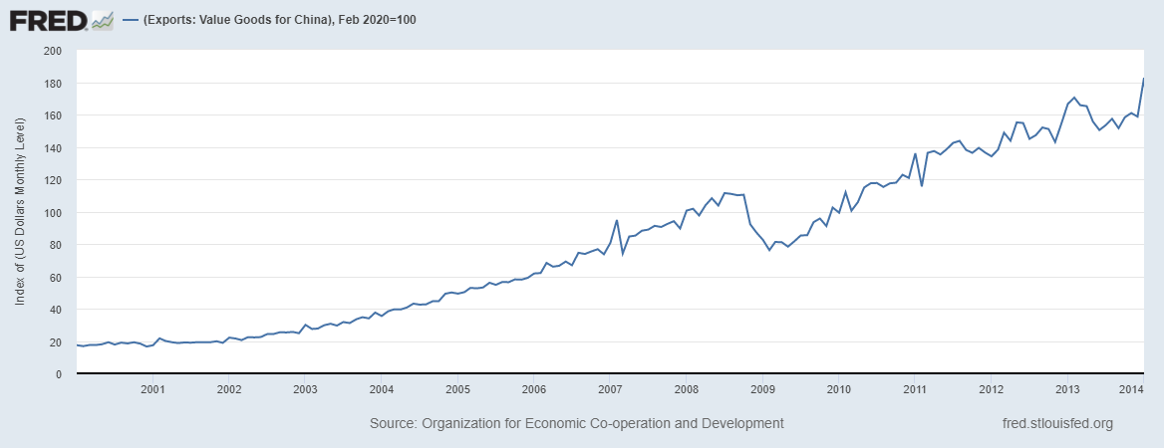
China’s Exports fall

Slide 38
The Economic Downturn is Global
As Investment and Consumption falls, GDP’s start to drop
This reduces import demand and hence export income for many countries
This reduces GDP…again
Globalisation has spread the crisis

Slide 39
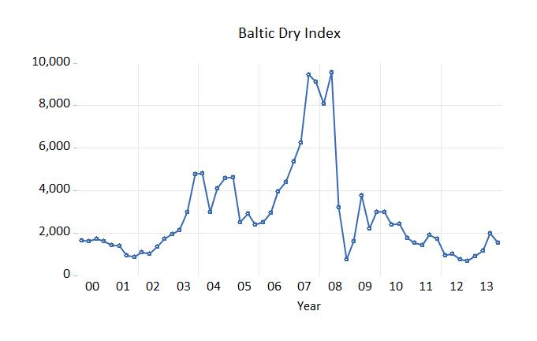
Container Shipping Costs collapse
The decline in trade leads to a rapid drop in costs of shipping containers globally.

Slide 40
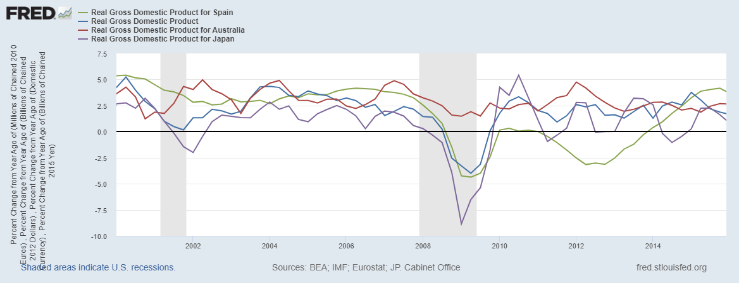
GDP growth

Slide 41
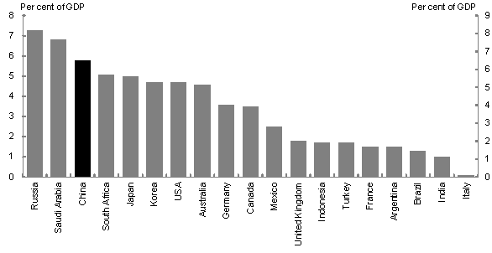
Fiscal Stimulus
This is the combined stimulus for 2009-10.
(First year was greatest)

Slide 42
Solutions: Fiscal Policy
Conventional macroeconomic policies were adopted
Many countries enacted expansionary fiscal policies within 3 months of the crisis (tax cuts, spending increases)
The OECD estimates OECD countries spent about 3.5% of GDP on their fiscal stimulus.
China spent 19%, Brazil spent 15%!
This was fast and large by pre-Covid19 standards
It was not enough to prevent recessions

Slide 43
China’s Fiscal Stimulus
RMB 1 trillion was for Sichuan earthquake reconstruction.
The distinct feature was investment focus.
74% allocated to infrastructure (e.g. highspeed railways).
Western economies allocated more to boost consumer spending.
An RMB 4 trillion package was announced in November 2008.
Actual new spending was less than this.

Slide 44
Solutions: Conventional Monetary Policy
Central Banks lowered interest rates aggressively
US Federal Reserve cut theirs to 0% in December 2008
European Central Bank cut theirs to 1%
Australia went from 7.25 to 3% by April 2009
NZ was similar dropping to 2.5% from around 7.5%
Ideally this prompts firms to go to financial markets to borrow for Investment.
But financial markets were not functioning…

Slide 45
Solutions: Restore Financial Markets
Bank deposit insurance and liability guarantees expanded
Depositers could be more confident about lending to Banks
Central Banks restructured or rescued the distressed banks.
Some still failed.
Restoring Bank balance sheets (non-performing loans) would take time.

Slide 46
Quantitative Easing: How does it work?
It works through the bond market.
A company might issue a bond ($1000) and offer $50 a year as payment.
The starting interest rate is 5%
The Central Bank creates money in its accounts, and buys bonds.
The demand for bonds rises and their price increases.
Example: The bond trades now for $1250. The interest rate is 50/1250 or 4%.
Spending increases because
The cost of borrowing falls
The return to financial assets goes down

Slide 47
Solutions: Quantitative Easing
The US Fed and Bank of England especially purchase long-term financial securities in large volume
These are shifted to the Central Banks ‘assets’ in the Balance sheet
Money from these purchases is then available to firms

Slide 48
Quantitative Easing
Quantitative easing allows the Central Bank to drive down interest rates when it hits the zero-bound limit.
Under normal circumstances it would be very inflationary.
Under the conditions of the GFC, the supply constraints that could cause inflation were absent.
Quantitative Easing was very experimental.
Central Banks had not used it before.

Slide 49
Austerity
Some countries had high sovereign risk
High debts meant financial markets considered them risky
These debt levels meant it Governments could not sell bonds to finance their deficits.
To balance their budget deep cuts in government spending had to implemented
This worsened the recession for these countries

Slide 50
Example 4.3
A financial crisis is triggered by:
A decline in consumer confidence.
A decline in house prices.
A decline in asset prices.
A decline in investment.
Select the best response to the following question.

Slide 51
Example 4.4
The initial decline in Investment in a financial crisis is caused by:
A decline in business confidence.
A drop in consumer spending on durables.
Interest rates in the economy are too high.
A credit-crunch.
Select the best response to the following question.

Slide 52
How did NZ and Australia get off lightly?
NZ was already in recession because of the 2007/8 drought, high oil prices and declining house prices.
Australia did not go into recession at all
Both countries recovered quickly compared to others.

Slide 53
Proposed Explanations
Australia and NZ exported commodities, not durable goods.
Prices for these remained high
Both economies had a strong Asian export focus
NZ signed FTA with China in 2008
Asian region was much less impacted.
Instead of experiencing a drop in NX, it rose to offset the GFC
Both countries also benefited from the large Chinese fiscal stimulus.

Slide 54
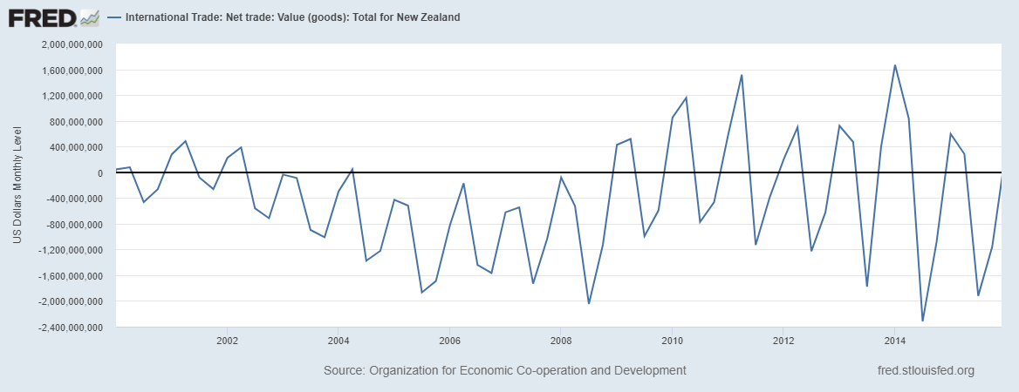
NZ Net Exports

Slide 55
Proposed Explanations
Australian and NZ Banks were not attracted to Mortgage-Backed securities
Both Reserve Banks were effective monitors, maintained a good regulatory framework to sustain bank balances.
There was no ‘real’ financial crisis in Australia and NZ.
No banks in this region needed assistance
15-30% did in US and UK
80%+ in countries like Belgium
Australasian Banks were more conservative
Regulatory measures were effective

Slide 56
Proposed Explanations
Both countries started the GFC in a period of (relatively) high interest rates and very low public debt.
This meant there was room for bigger interest rate cuts than the US or UK
Low (net) public debt made it easier to borrow money to run deficits for fiscal expansion
While both countries increased public debt, it didn’t reach levels some countries started the GFC with.
Lowered debt goals became part of NZ fiscal stance from 1994.
From 2002-08 NZ Gross Public Debt was maintained at 20% of GDP.
Greece was 109%

Slide 57
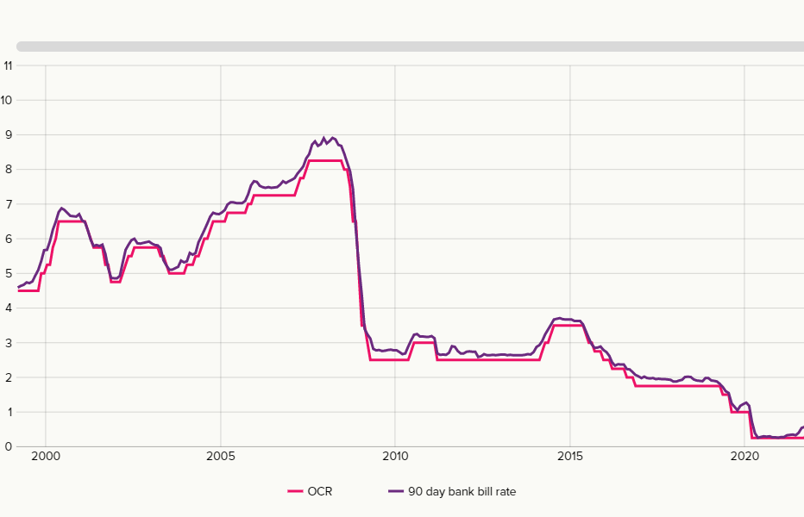
NZ OCR

Slide 58
Lessons of the GFC?
What lessons can be drawn from the GFC for macroeconomic management?
Are these lessons applicable to the Covid19 shock?

